Slide 1

Regression And Decision Trees
May 2018
Bangalore
May 2018
Bangalore

Slide 2
Regression Analysis
➢ Regression Analysis is a tool for finding a relationship between a dependent variable and one or more independent variables in a study.
➢ A relationship can be linear or non-linear.
➢ The basic function is to identify statistically significant in dependent variables and estimate the model parameters.

Slide 3
➢ How MRP affects the purchase decision?
➢ Which promotion is more effective?
➢ What is the risk associated with price increase on customer retention?
➢ Which customer is likely to default?
➢ What percentage of loans is likely to result in a loss?
➢ How to identify the most profitable customer?
➢ Which is the most effective channel for advertisement?
➢ What factors determine the prices of houses?
➢ What is the best response to reduce marketing spend?

Slide 4
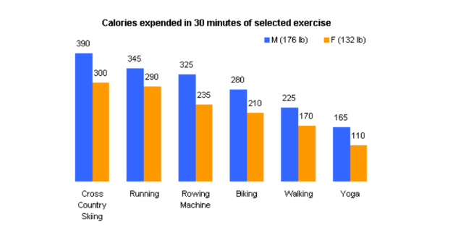
What is Regression?
➢ What is the relationship between exercise duration and calories burnt? Is it linear or curvilinear?

Slide 5
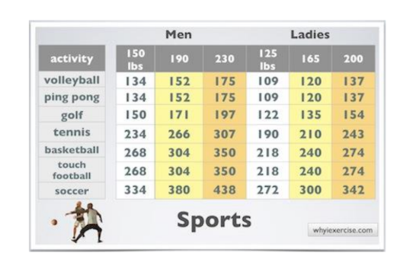
➢ Does exercise have less impact on the number of calories burned after a certain point?

Slide 6
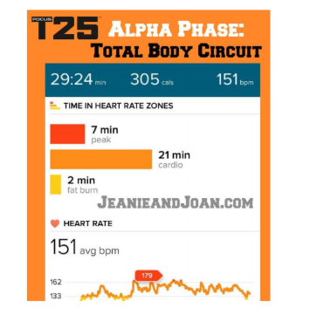
➢ How does effort (percentage of time at the target heart rate, the average walking speed) factor in?

Slide 7
➢ Every functional area of management uses Regression:
• Finance – Chance of bankruptcy, Credit risk fraud
• Marketing – Sales, Market share, Customer satisfaction, Customer churn, Customer Retention, Customer Life-time Value
• Operations – Inventory, Productivity, Efficiency
• HR – Job satisfaction, Attrition
• HealthCare – New plans, Health Insurance

Slide 8
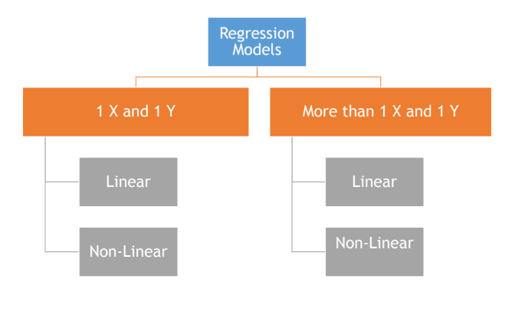
Types Of Regression Analysis

Slide 9
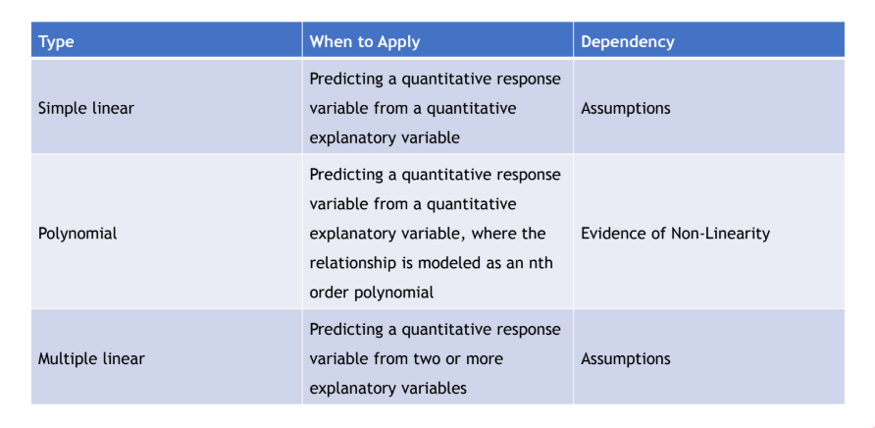
Types Of Regression Analysis

Slide 10
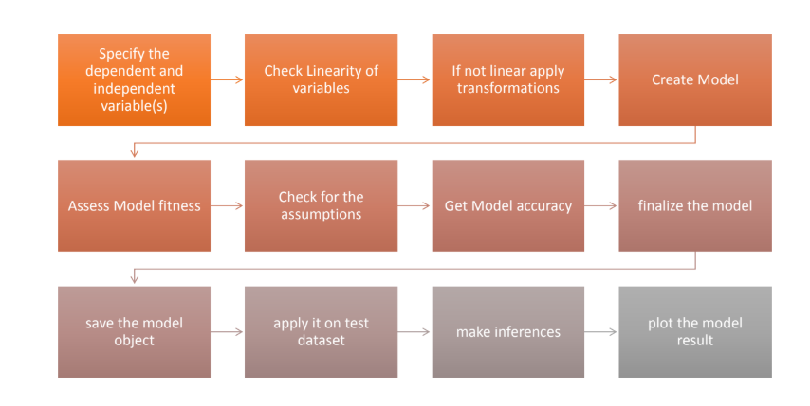
Steps For Regression Analysis

Slide 11
Regression
Dependent variable
Independent variable (x)
Regression is the attempt to explain the variation in a dependent variable using the variation in independent variables.
Regression is thus an explanation of causation.
If the independent variable(s) sufficiently explain the variation in the dependent variable, the model can be used for prediction.

Slide 12
Simple Linear Regression
y’ = b0 + b1X ± є
є
Dependent variable (y)
B1 = slope
= ∆y/ ∆x
b0 (y intercept)
Independent variable (x)
The output of a regression is a function that predicts the dependent variable based upon values of the independent variables.
Simple regression fits a straight line to the data.
………..

Slide 13
Simple Linear Regression
Observation: y
^
Prediction: y
Dependent variable
Zero
Independent variable (x)
The function will make a prediction for each observed data point.
The observation is denoted by y and the prediction is denoted by y.
^

Slide 14
Simple Linear Regression
Prediction error: ε
Observation: y
^
Prediction: y
Zero
For each observation, the variation can be described as:
y = y + ε
Actual = Explained + Error
^

Slide 15
Regression
Dependent variable
Independent variable (x)
A least squares regression selects the line with the lowest total sum of squared prediction errors.
This value is called the Sum of Squares of Error, or SSE.

Slide 16
Calculating SSR
Population mean: y
Dependent variable
Independent variable (x)
The Sum of Squares Regression (SSR) is the sum of the squared differences between the prediction for each observation and the population mean.

Slide 17
The Total Sum of Squares (SST) is equal to SSR + SSE.
Mathematically,
SSR = ∑ ( y – y ) (measure of explained variation)
SSE = ∑ ( y – y) (measure of unexplained variation)
SST = SSR + SSE = ∑ ( y – y ) (measure of total variation in y)
^
2
^
2

Slide 18
The proportion of total variation (SST) that is explained by the regression (SSR) is known as the Coefficient of Determination, and is often referred to as R .
R = SSR/SST = SSR/(SSR + SSE)
The value of R can range between 0 and 1, and the higher its value the more accurate the regression model is. It is often referred to as a percentage.
2
2

Slide 19
Standard Error of Regression
The Standard Error of a regression is a measure of its variability. It can be used in a similar manner to standard deviation, allowing for prediction intervals.
y ± 2 standard errors will provide approximately 95% accuracy, and 3 standard errors will provide a 99% confidence interval.
Standard Error is calculated by taking the square root of the average prediction error.
√
SSE
n-k
Standard Error =
Where n is the number of observations in the sample and
k is the total number of variables in the model

Slide 20

Decision tree is a type of supervised learning algorithm (having a pre-defined target variable) that is mostly used in classification problems. It works for both categorical and continuous input and output variables. In this technique, we split the population or sample into two or more homogeneous sets (or sub-populations) based on most significant splitter / differentiator in input variables.

Slide 21
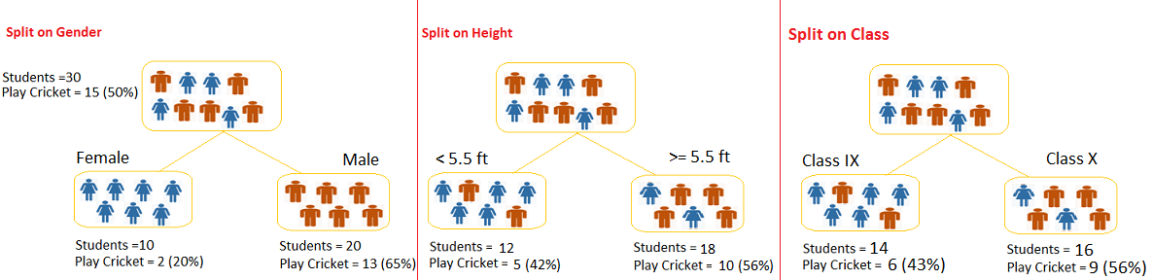
Let’s say we have a sample of 30 students with three variables Gender (Boy/ Girl), Class( IX/ X) and Height (5 to 6 ft). 15 out of these 30 play cricket in leisure time. Now, I want to create a model to predict who will play cricket during leisure period? In this problem, we need to segregate students who play cricket in their leisure time based on highly significant input variable among all three.

Slide 22
Types of Decision Trees
Types of decision tree is based on the type of target variable we have. It can be of two types:
Categorical Variable Decision Tree: Decision Tree which has categorical target variable then it called as categorical variable decision tree.
Example:- In above scenario of student problem, where the target variable was “Student will play cricket or not” i.e. YES or NO.
Continuous Variable Decision Tree: Decision Tree has continuous target variable then it is called as Continuous Variable Decision Tree.
Example:- Let’s say we have a problem to predict whether a customer will pay his renewal premium with an insurance company (yes/ no). Here we know that income of customer is a significant variable but insurance company does not have income details for all customers. Now, as we know this is an important variable, then we can build a decision tree to predict customer income based on occupation, product and various other variables. In this case, we are predicting values for continuous variable.

Slide 23
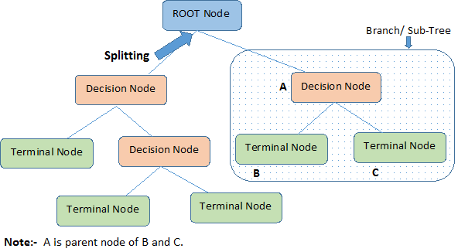
Important Terminology related to Decision Trees
Notes:
Let’s look at the basic terminology used with Decision trees:
Root Node: It represents entire population or sample and this further gets divided into two or more homogeneous sets.
Splitting: It is a process of dividing a node into two or more sub-nodes.
Decision Node: When a sub-node splits into further sub-nodes, then it is called decision node.
Leaf/ Terminal Node: Nodes do not split is called Leaf or Terminal node.
Branch / Sub-Tree: A sub section of entire tree is called branch or sub-tree.

Slide 24
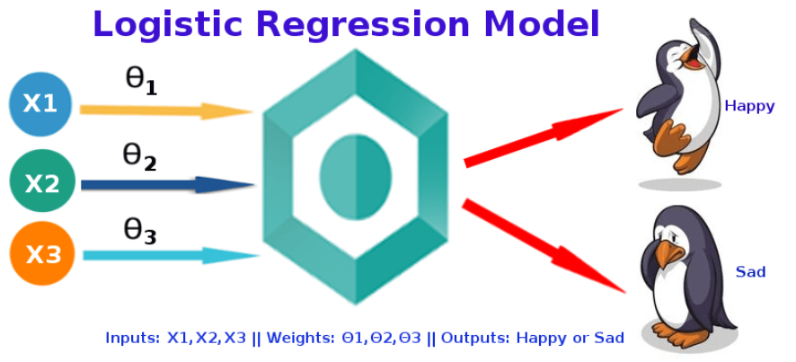
“Logistic regression measures the relationship between the categorical dependent variable and one or more independent variables by estimating probabilities using a logistic function”
Logistic Regression was used in the biological sciences in early twentieth century. It was then used in many social science applications. Logistic Regression is used when the dependent variable(target) is categorical.
For example,
To predict whether an email is spam (1) or (0)
Whether the tumor is malignant (1) or not (0)

Slide 25
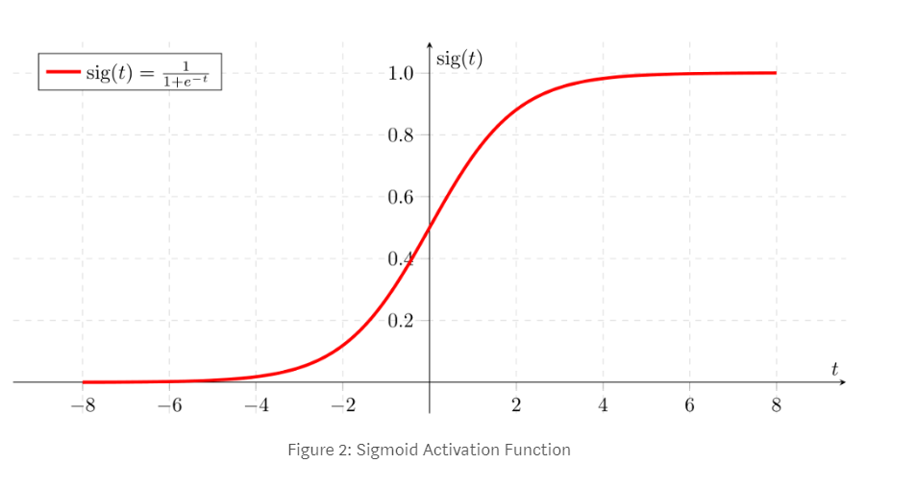
Sigmoid Function
If ‘Z’ goes to infinity, Y(predicted) will become 1 and if ‘Z’ goes to negative infinity, Y(predicted) will become 0.

Slide 26
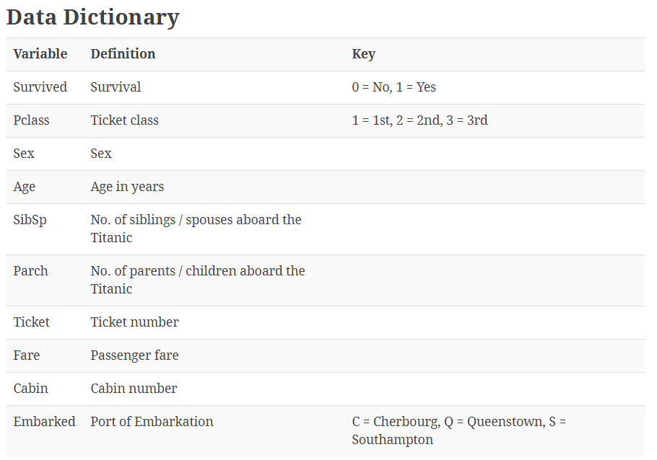

Slide 27
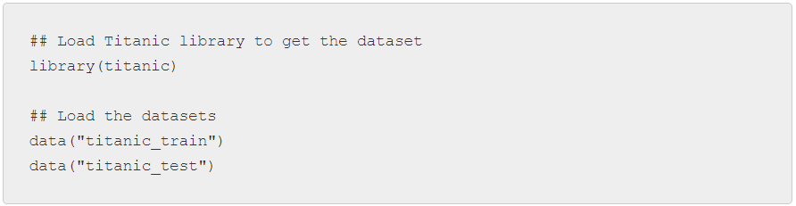
R Code
Loading the dataset
Titanic package in R has both training and test datasets. So we will use this package to directly load the dataset.

Slide 28
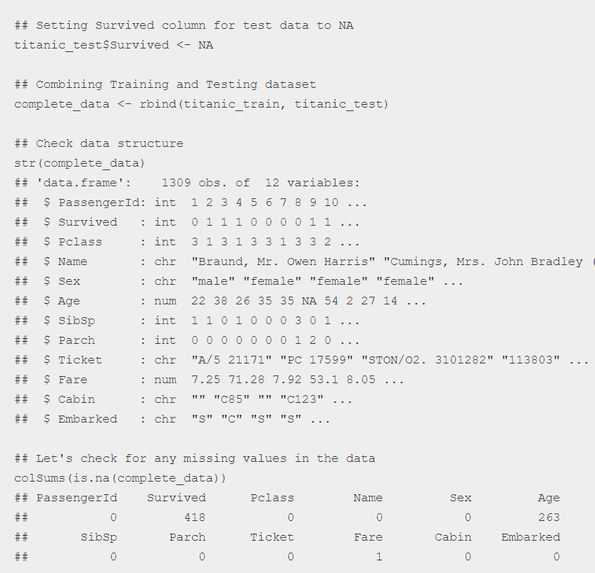
Data details and missing values imputation

Slide 29
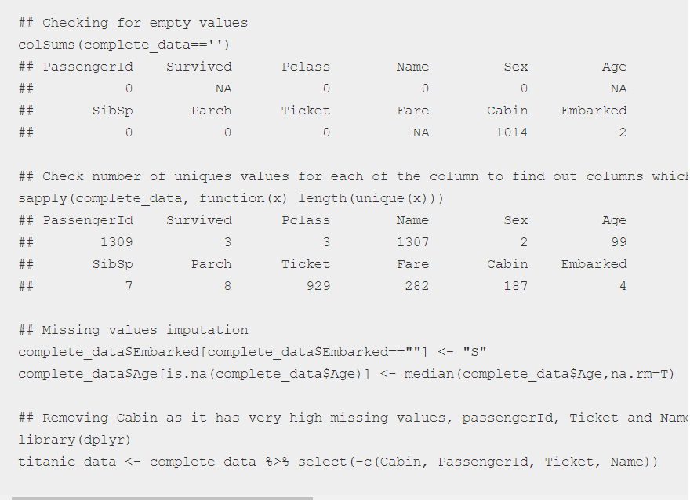

Slide 30
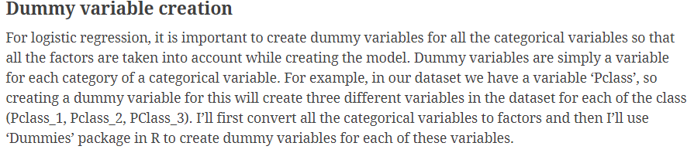
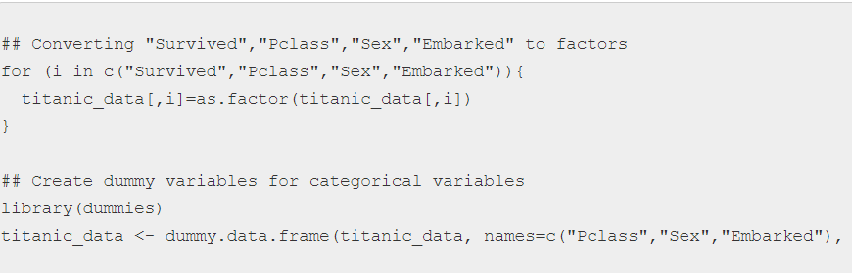
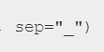

Slide 31
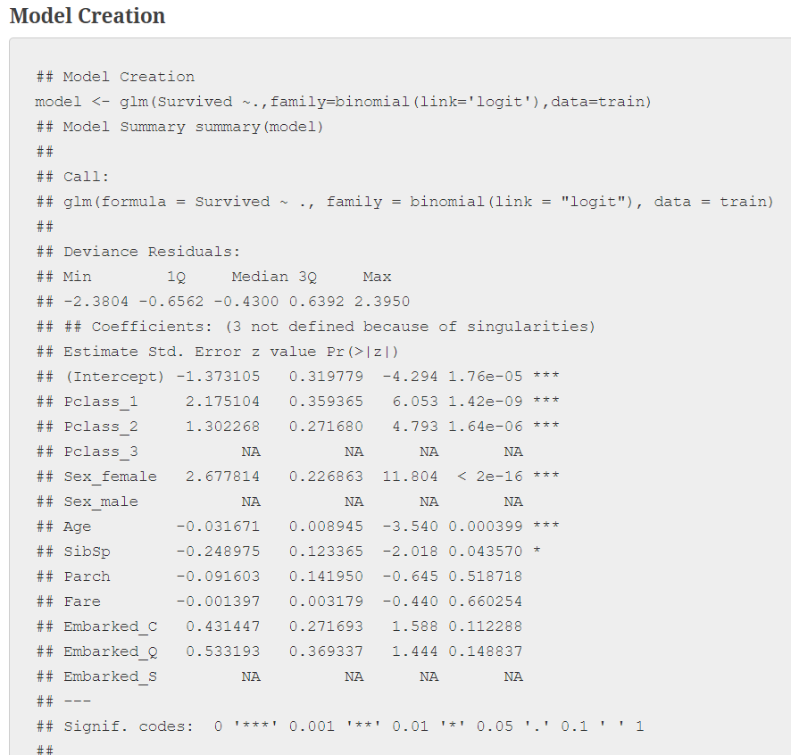

Slide 32
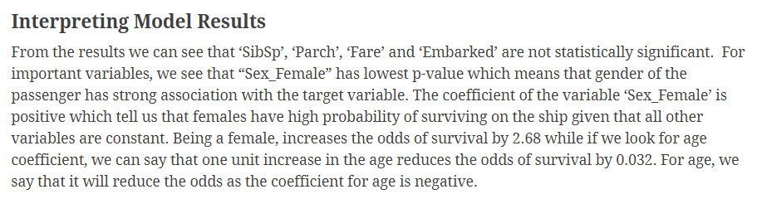

Slide 33
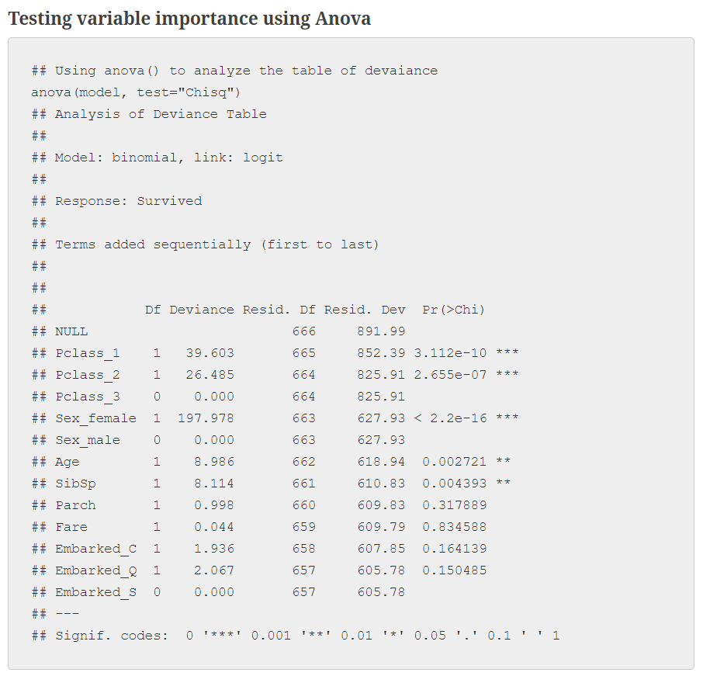
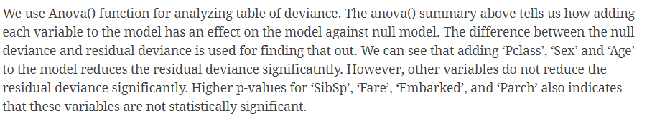

Slide 34
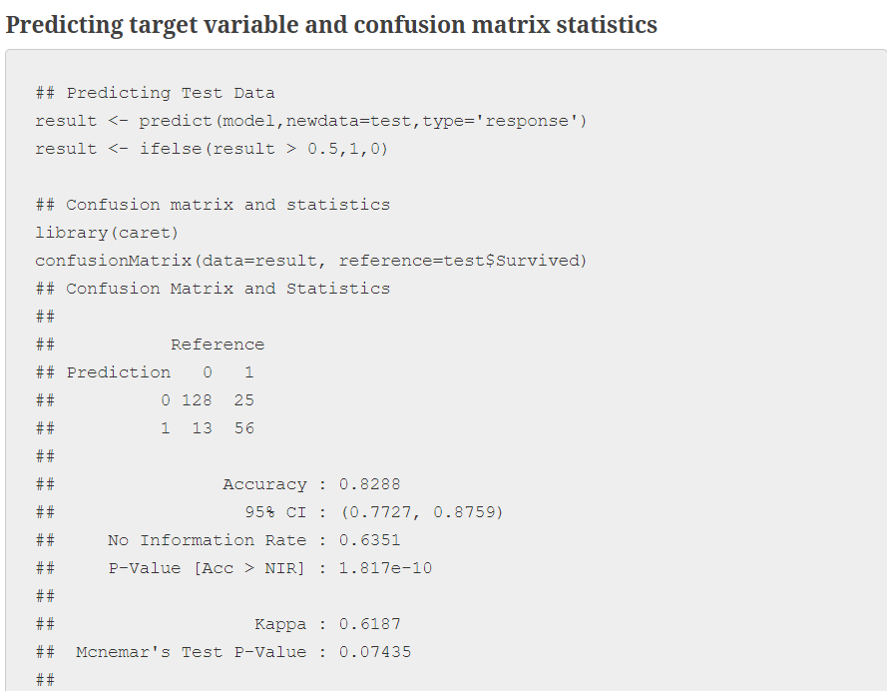

Slide 35
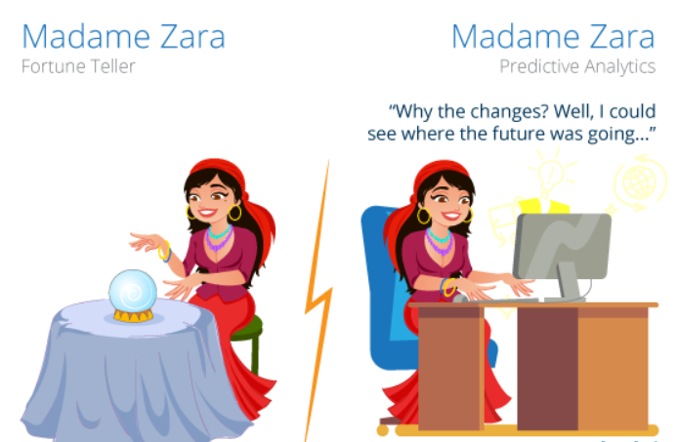
Machine Learning
Machine Learning is a subset of artificial intelligence. It focuses mainly on the designing of systems, thereby allowing them to learn and make predictions based on some experience which is data in case of machines.
Machine Learning enables the computers to act and make data-driven decisions rather than being explicitly programmed in order to carry out a certain task. These programs or algorithms are designed to learn and improve over time when exposed to new data.

Slide 36

Machine Learning
Today machine learning is the core of many Futuristic technological advancements in our world.
Look around you, you will find various examples or implementations of machine learning, such as Tesla’s,Google Voice Assistant, self-driving cars, Apple’s Siri, Sophia AI Robot,Recommendation Engine and many more.

Slide 37
Machine Learning
How does Machine Learning Work?
Machine Learning algorithm is trained using a training data set to create a model.
When new input data is introduced to the ML algorithm, it makes a prediction on the basis of the model.
The prediction is evaluated for accuracy and if the accuracy is acceptable, the ML algorithm is deployed. If the accuracy is not acceptable, the ML algorithm is trained again and again with an augmented training data set.
This is just a very high-level example as there are many factors and other steps involved.

Slide 38
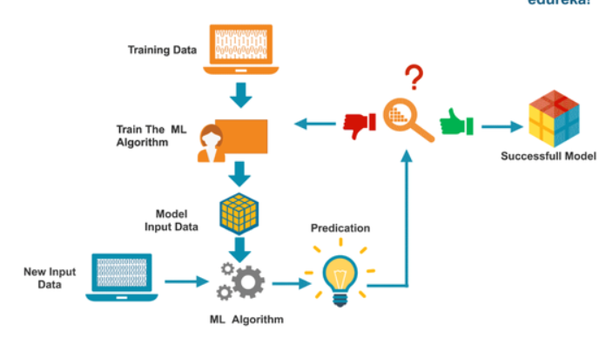
Machine Learning

Slide 39
Machine Learning
Types of Machine Leaning
Machine learning is sub-categorized to three types:
Supervised Learning – Train Me
Unsupervised Learning – I am self sufficient in learning
Reinforcement Learning – My life My rules! (Hit & Trial)
What is Supervised Learning?
It is a process of an algorithm learning from the training dataset. You can think it as a teacher supervising the learning process. Where you know the correct answers but the algorithm iteratively keeps predicting the training data and is corrected by the teacher. This learning stops when the algorithm achieves an acceptable level of performance.

Slide 40
Machine Learning
What is Unsupervised Learning?
In this process of learning, no one supervises the process, there are no correct answers and there is no teacher. Algorithms are left to their own to discover and present the interesting structure in the data.
In the unsupervised learning, the data instances of a training dataset do not have an expected output associated with them. Instead, the algorithm detects patterns based on the original characteristics of the input data. An example of unsupervised learning is clustering. In this, similar data instances are grouped together in order to identify clusters of data.
What is Reinforcement Learning?
Reinforcement learning can be thought of as a hit and trial method. A Reward or Penalty point is given for each action. If the machine chooses a correct option it gains the reward point and vice-versa.

Slide 41
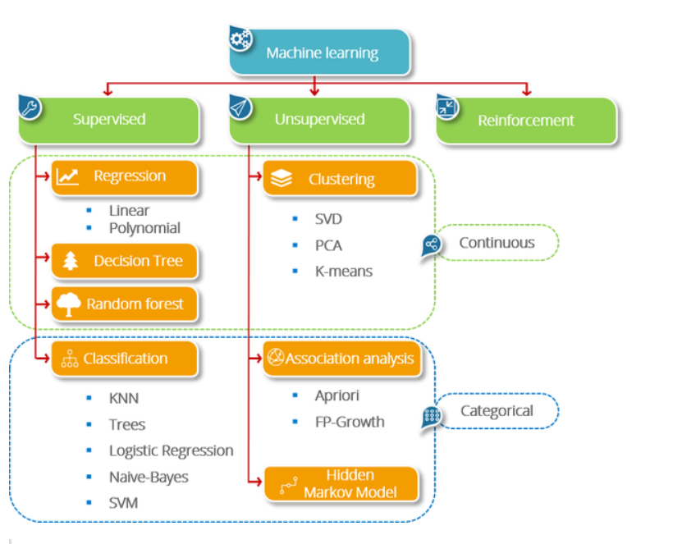

Slide 42
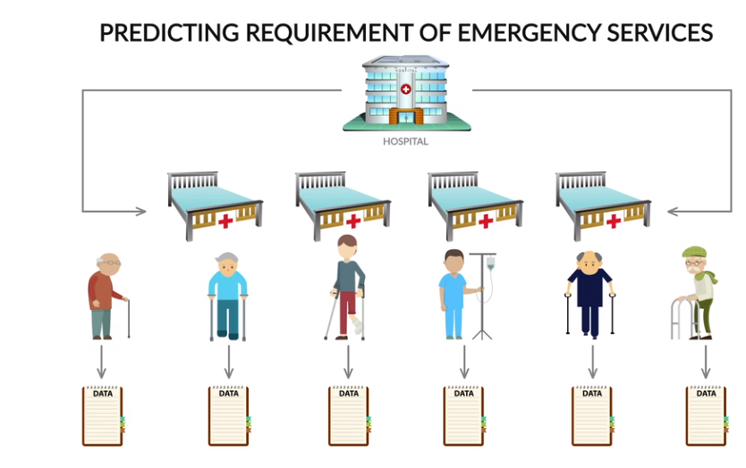

Slide 43
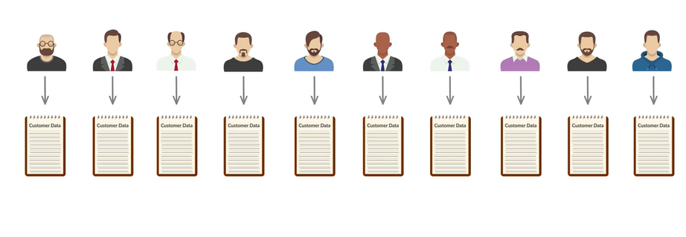
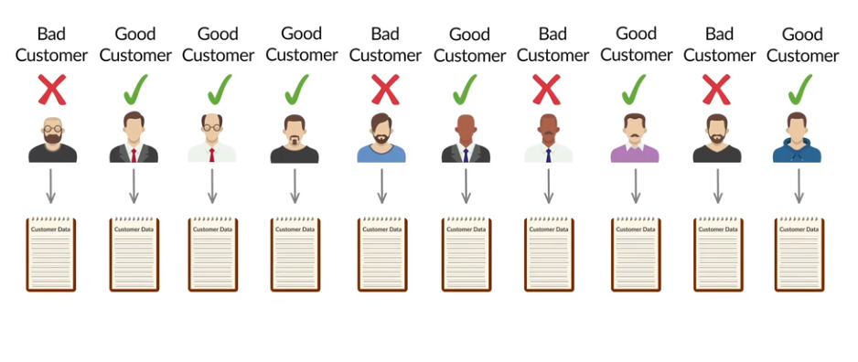
Machine Learning

Slide 44
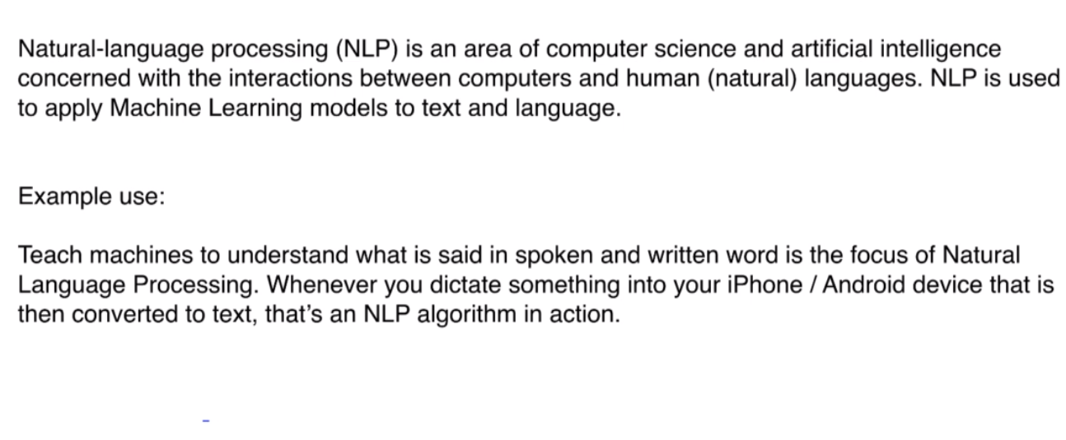
NLP

Slide 45
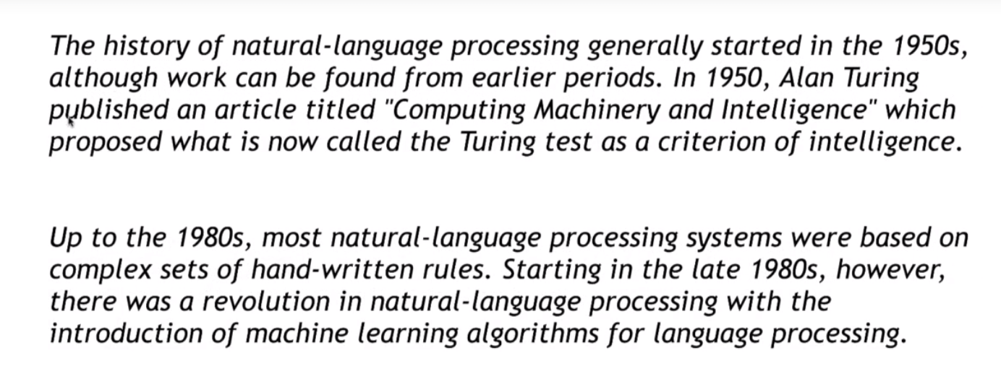
History of NLP

Slide 46
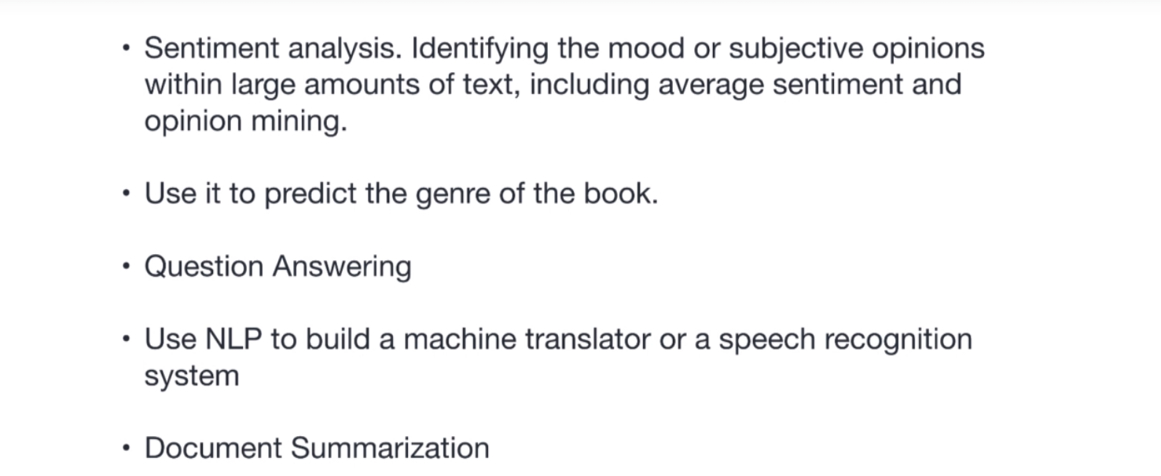
Uses of NLP

